Slide 1

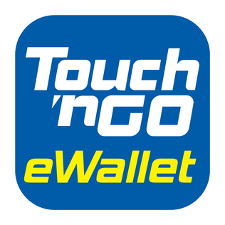
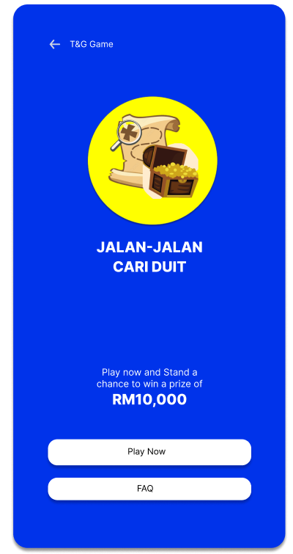
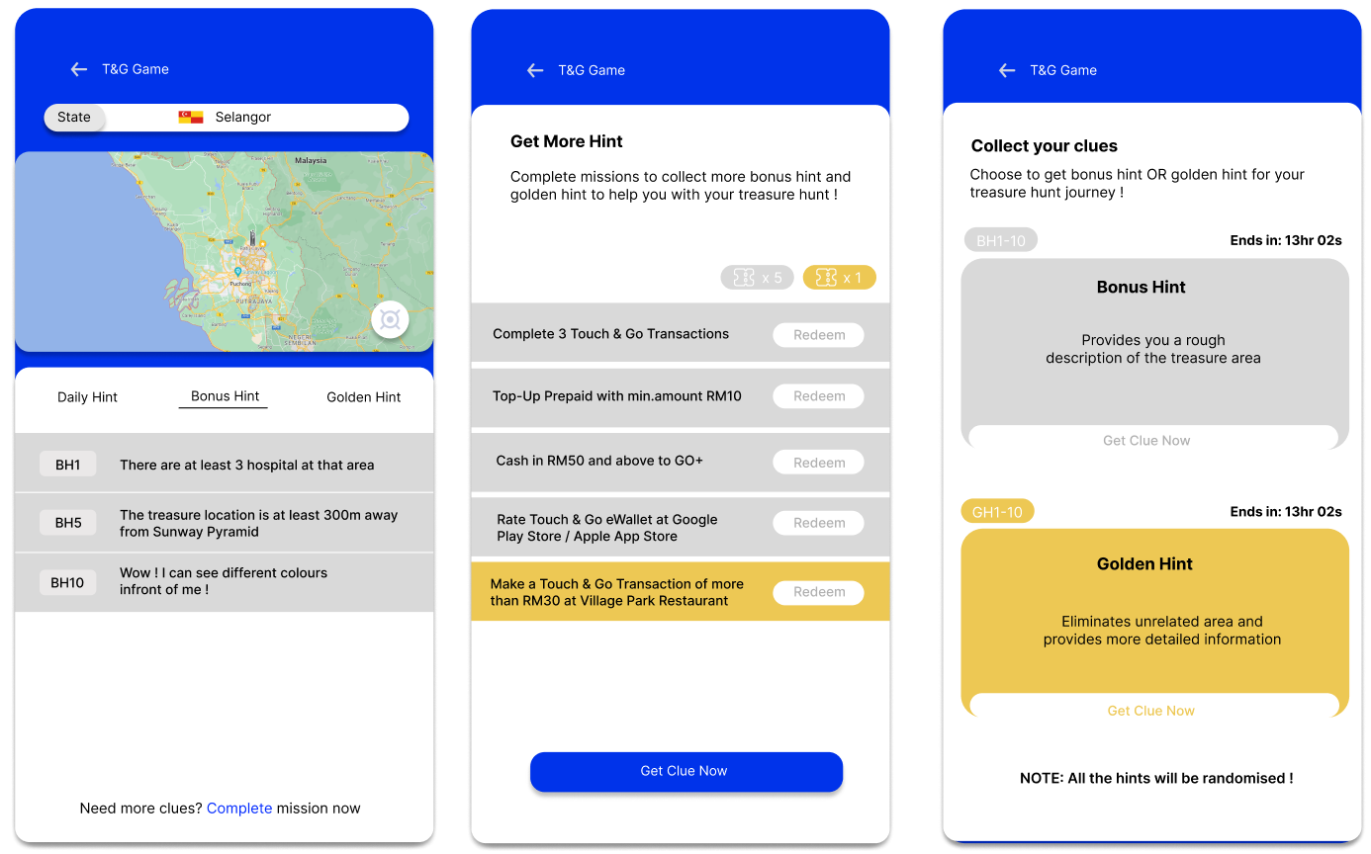
TNG Treasure Hunt
T&G Treasure Hunt
Play the game “Jalan-Jalan Cari Duit” after reading the FAQs
Complete more missions to collect more bonus/golden hint tickets
1
3
View hints and search for the treasure hunt areas
Get your clue and find the treasure!
2
4

Slide 2
Problem Statement
The ever-growing adoption of digital payments in Malaysia encourages the emergence of more e-wallet licensed operators to serve a mere population of 30 millions. To stand out from the competitors, an innovative and interactive campaign is required to attract and recruit potential new users. The current gamification in TNG requires users to pay for an entrance fee to be eligible to earn tickets and win rewards through the leaderboard ranking. This discourages the users to play the game as they need to pay in advance. Besides, the game is not creative and attractive enough for users to keep on playing which causes less users to participate in current TNG game

Slide 3
Market/Consumer Needs
01
Sense of accomplishment in completing quests
02
Rewards upon achieving goals

Slide 4
Value Proposition
Referral system
Gain creators
Bonus
Rewards
Progress bar
Daily check-in bonus
Surprise
Virtual treasure hunt
Satisfaction
Gains
Team mode
Engagement
Earn rewards
Fun
Clues through more transactions
Cash prize up to hundreds/thousands ringgit
Job-To-Be-Done
Entertainment
Products & services
Spend time
Fun quests
Lack of product engagement
Play game
User-friendly control
Boring application experience
Poor UI design
Ad-hoc event
Pains
Hints
Challenging puzzle solving
Difficult tasks
Unattractive rewards
Pain relievers
Unclear instructions

Slide 5
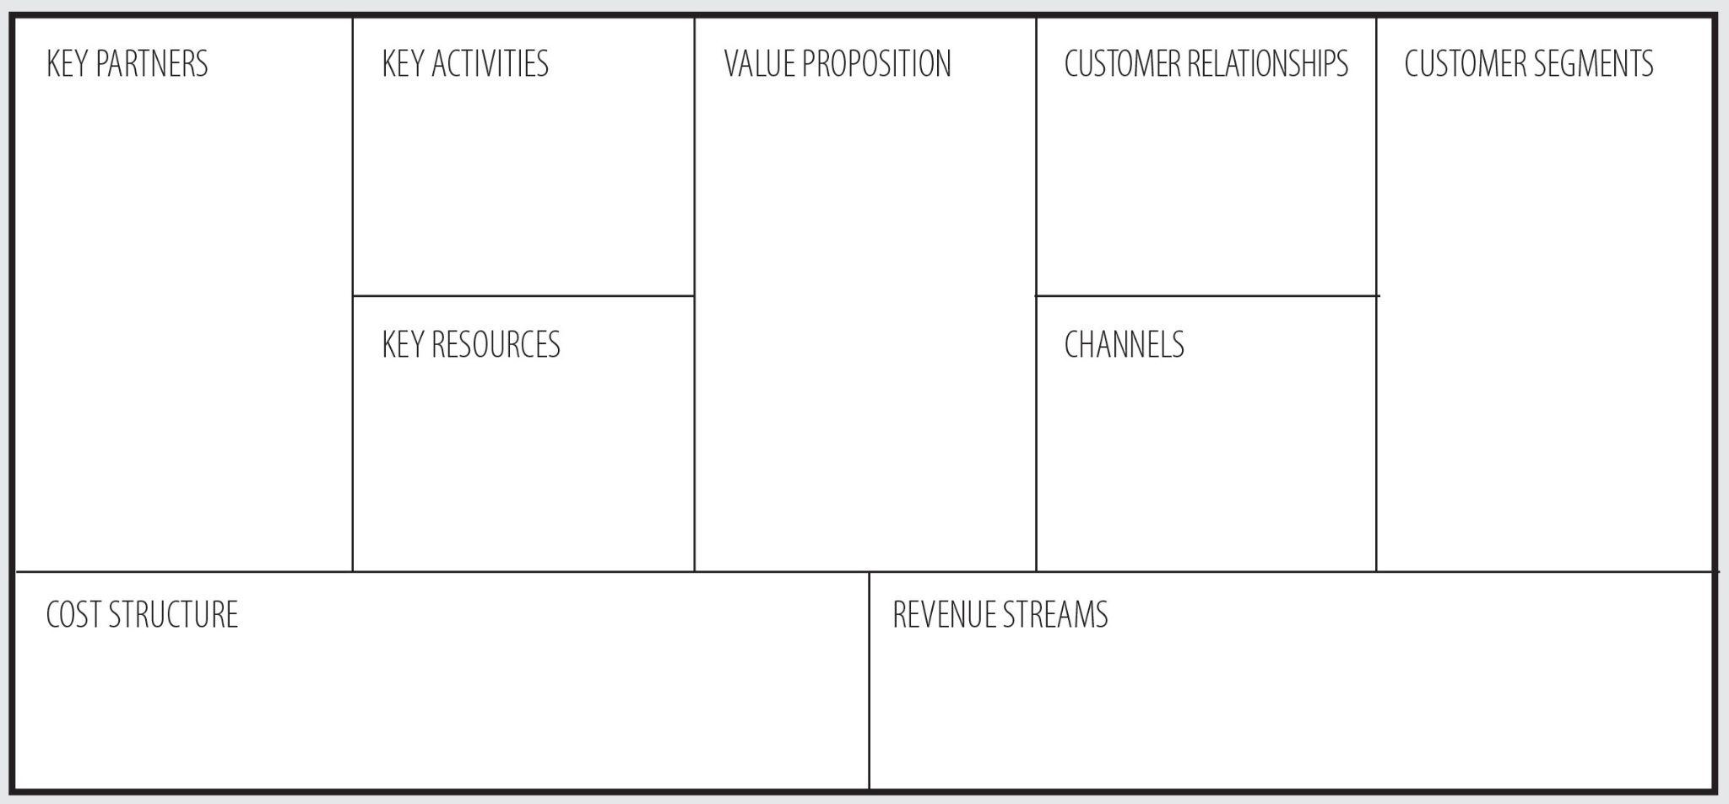
Business Model
Game Development Team
Platform Development and maintenance
Incentive to win the prizes by participate in game playing
Game that provided within TNG E-Wallet Apps
Millennials
Company providing gift and cash voucher
Marketing
TNG E-Wallet user
Game Development
Prizes Sponsor
Ad-hoc event
Game Lover
Virtual Treasure hunt
TNG E-Wallet platform
TNG e-wallet app
TNG E-Wallet ‘s existing users
More interactive apps
Game within TNG E-Wallet apps
Rewards of the game
Platform Development and maintenance
Advertisement
Enhance user engagement
Marketing
Game Development Cost
Increase in apps spending
Increase customer base

Slide 6
Closing Remarks
Mobile applications have become more prevalent in our daily lives. However, keeping users engaged has been one of the greatest challenges faced by organisations who operates these applications. Gamification has proven to be a promising way for enhancing users engagement. Gamifying mobile applications provides positive digital user experiences, while attracting more customers and increasing profitability. The elements help to trigger a sense of accomplishment, leading to an increase motivations to share and use the application.

